Slide 1
DOCUMENTATION STEP BY STEP HOW TO USE AWS EMR
Aditya Perwira Joan Dwitama

Slide 2
Install JAVA

Slide 3
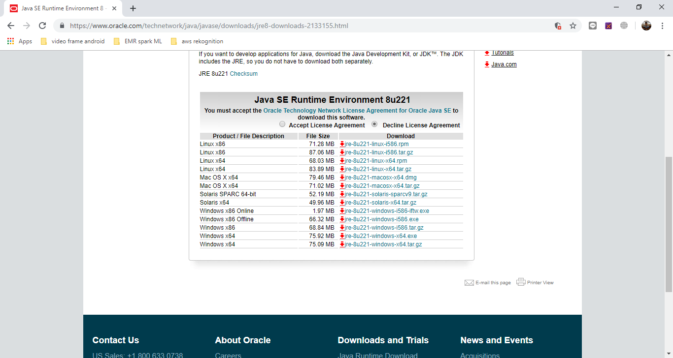
Download first and install normally
https://www.oracle.com/technetwork/java/javase/downloads/jre8-downloads-2133155.html

Slide 4
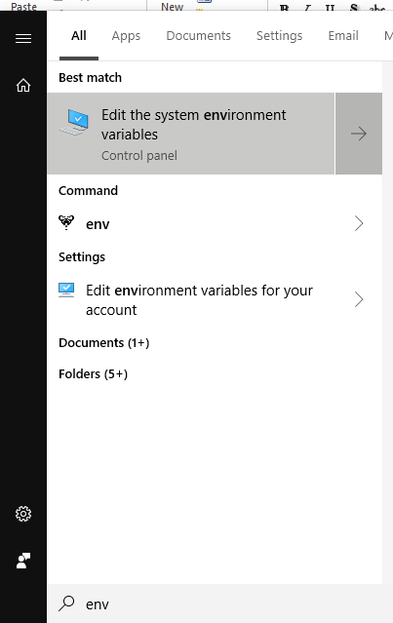
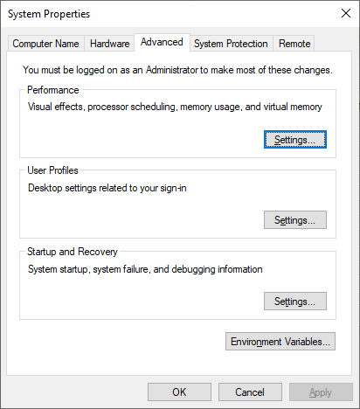
Open System Propertise and click environment variable

Slide 5
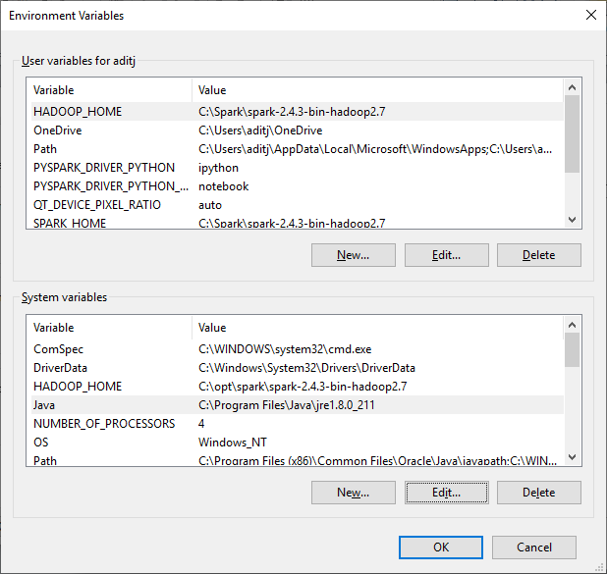
Create new java system variabel

Slide 6
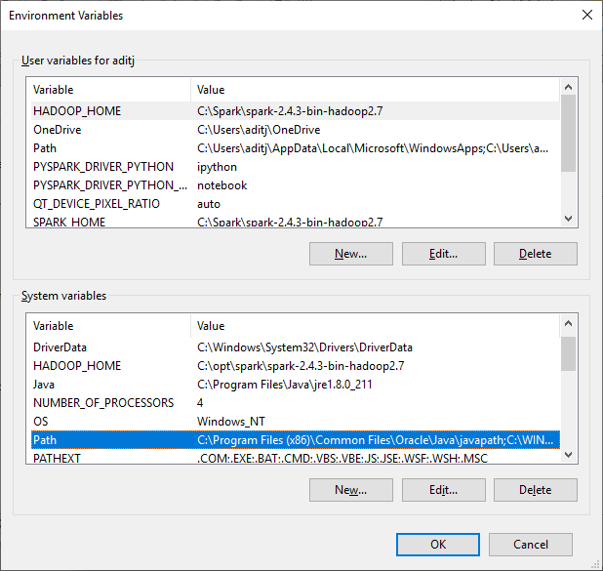
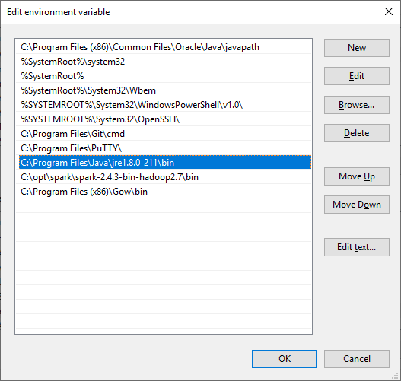
Create new java path

Slide 7
INSTALL GNU on Windows to run linux script on command line

Slide 8

Download GNU
https://github.com/bmatzelle/gow/releases/download/v0.8.0/Gow-0.8.0.exe

Slide 9
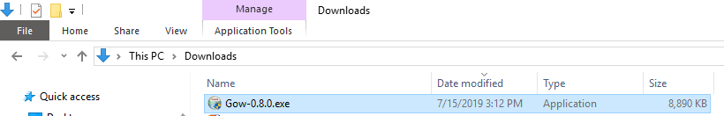
Install it

Slide 10
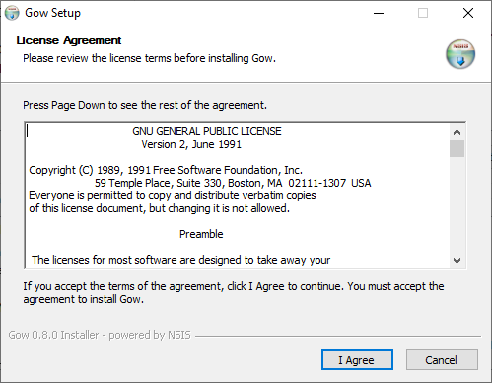
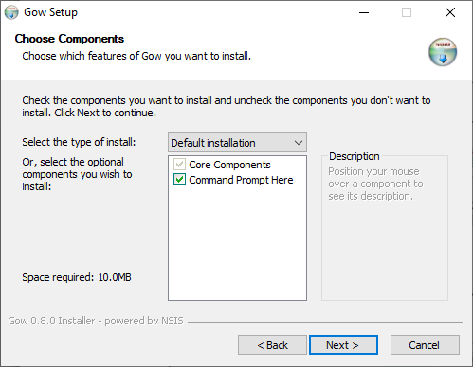

Slide 11
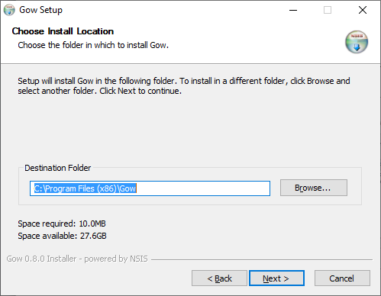
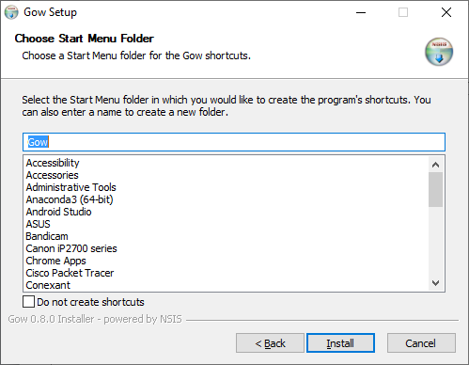

Slide 12
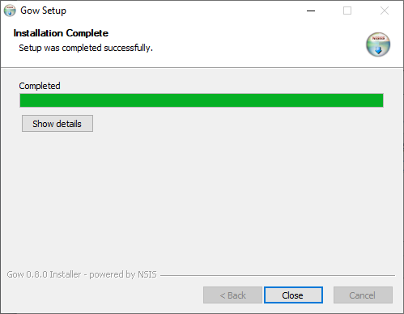

Slide 13
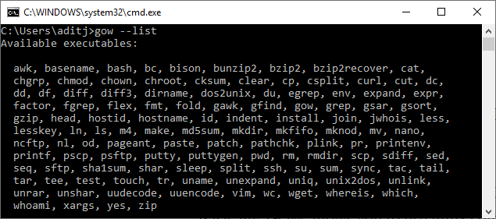
open command line and cek GNU

Slide 14
INSTALL Anaconda to write python code and run jupyter

Slide 15
Download Anaconda

Slide 16
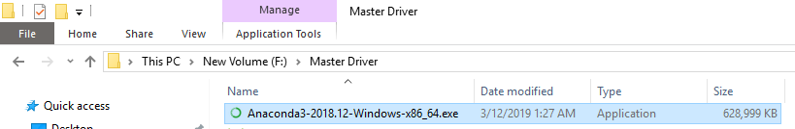
Install Anaconda

Slide 17
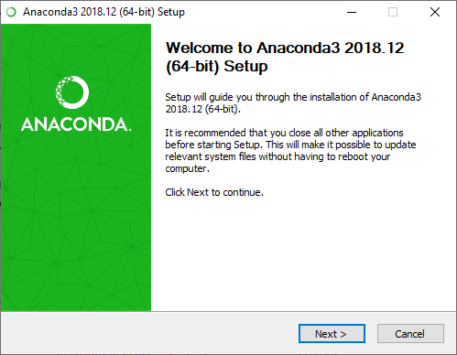
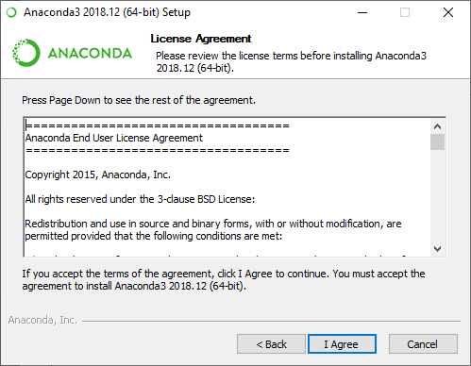

Slide 18
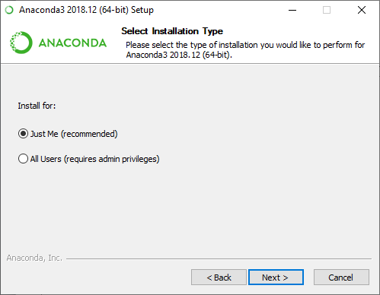
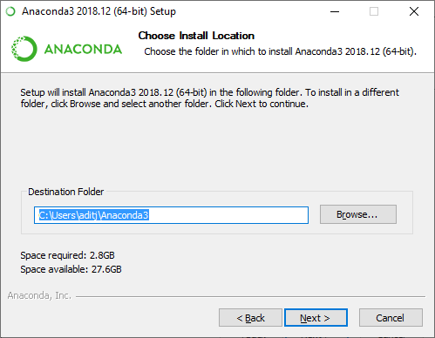

Slide 19
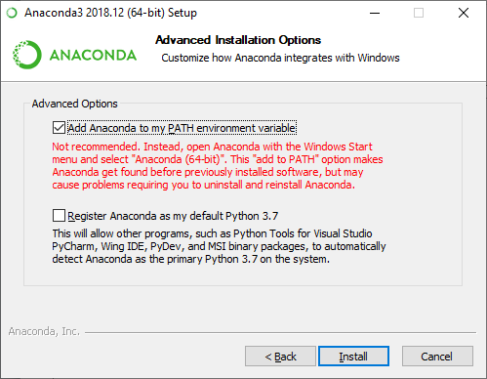

Slide 20
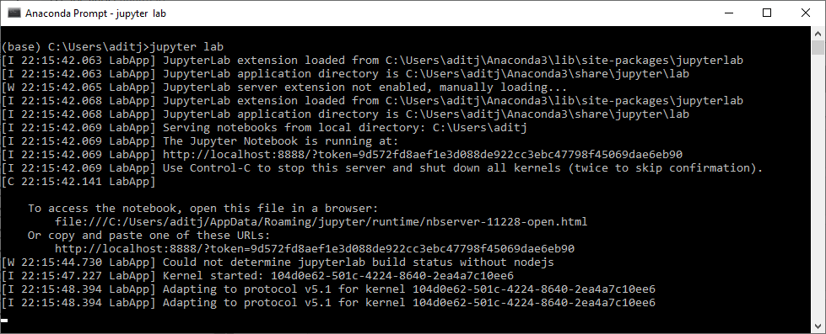
Open Anaconda Prompt and tes anaconda jupyter

Slide 21
Set UP SPARK on Windows

Slide 22
Download Spark

Slide 23
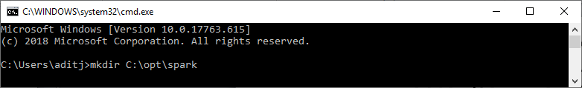
Open Command Line and Make New Directory on Disk C
C:\Users\aditj>mkdir C:\opt\spark

Slide 24
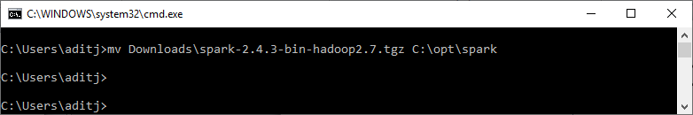
Move Spark.tgz to New DIrectory
C:\Users\aditj>mv Downloads\spark-2.4.3-bin-hadoop2.7.tgz C:\opt\spark

Slide 25
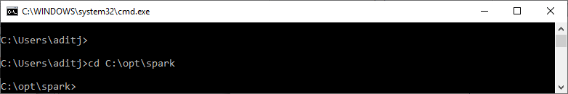
Go to Spark New Directory
C:\Users\aditj>cd C:\opt\spark

Slide 26
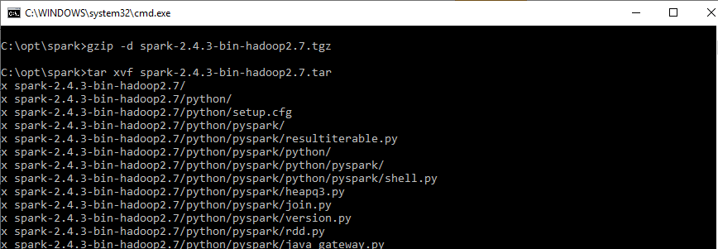
Extract it
C:\opt\spark>gzip -d spark-2.4.3-bin-hadoop2.7.tgz
C:\opt\spark>tar xvf spark-2.4.3-bin-hadoop2.7.tar

Slide 27
ADD winutils.exe to spark

Slide 28
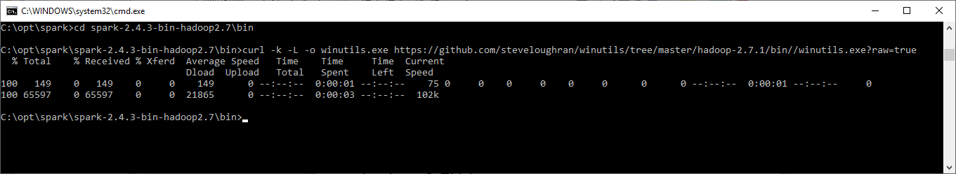
Go to diretory bin and download winutils
C:\opt\spark>cd spark-2.4.3-bin-hadoop2.7\bin
C:\opt\spark\spark-2.4.3-bin-hadoop2.7\bin>curl -k -L -o winutils.exe https://github.com/steveloughran/winutils/tree/master/hadoop-2.7.1/bin//winutils.exe?raw=true

Slide 29
Add environment variable via command line

Slide 30
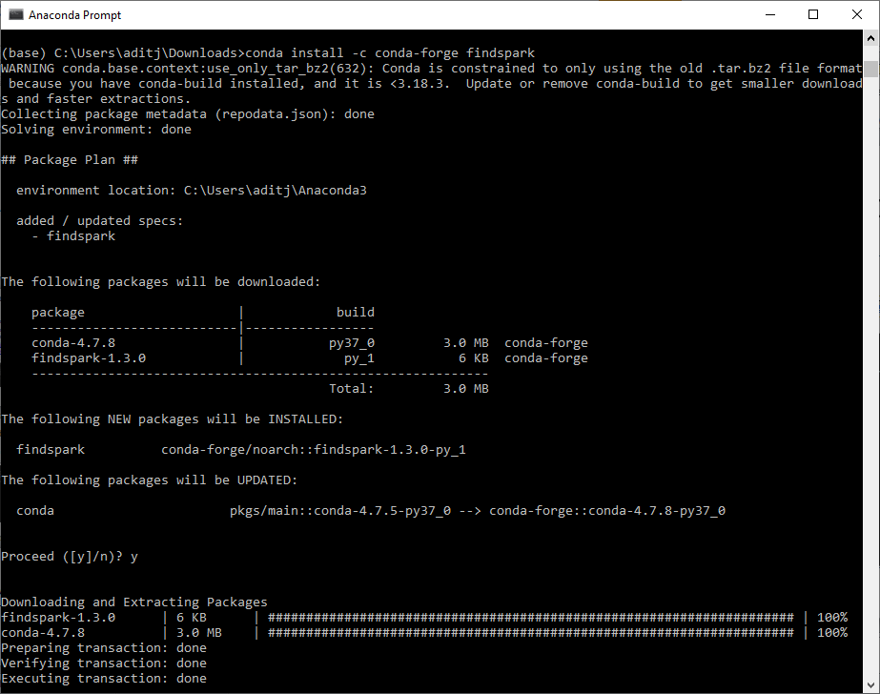
Add find spark on anaconda
conda install -c conda-forge findspark

Slide 31
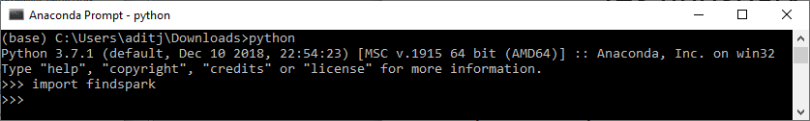
Tes findspark
python
import findspark
If there is no error, its mean that findspark successfully add to anaconda library

Slide 32
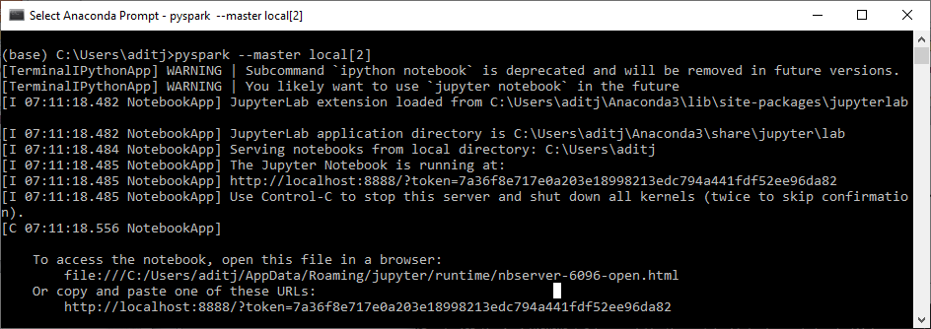
Try to run an ML algorithm on jupyter
pyspark --master local[2]

Slide 33
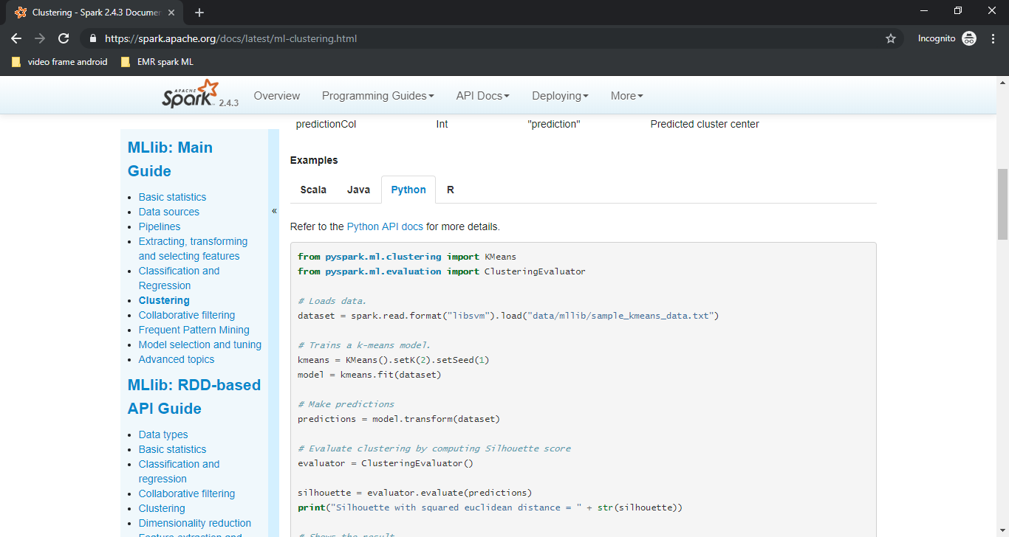
Copy python ML algorithm code on https://spark.apache.org/docs/latest/ml-clustering.html

Slide 34
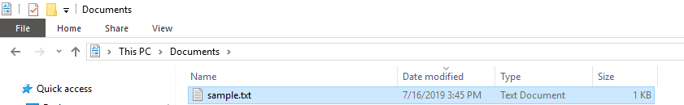
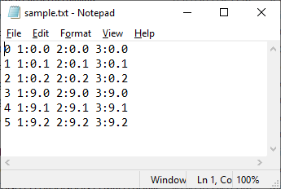
Make example file dataset txt
0 1:0.0 2:0.0 3:0.0
1 1:0.1 2:0.1 3:0.1
2 1:0.2 2:0.2 3:0.2
3 1:9.0 2:9.0 3:9.0
4 1:9.1 2:9.1 3:9.1
5 1:9.2 2:9.2 3:9.2

Slide 35
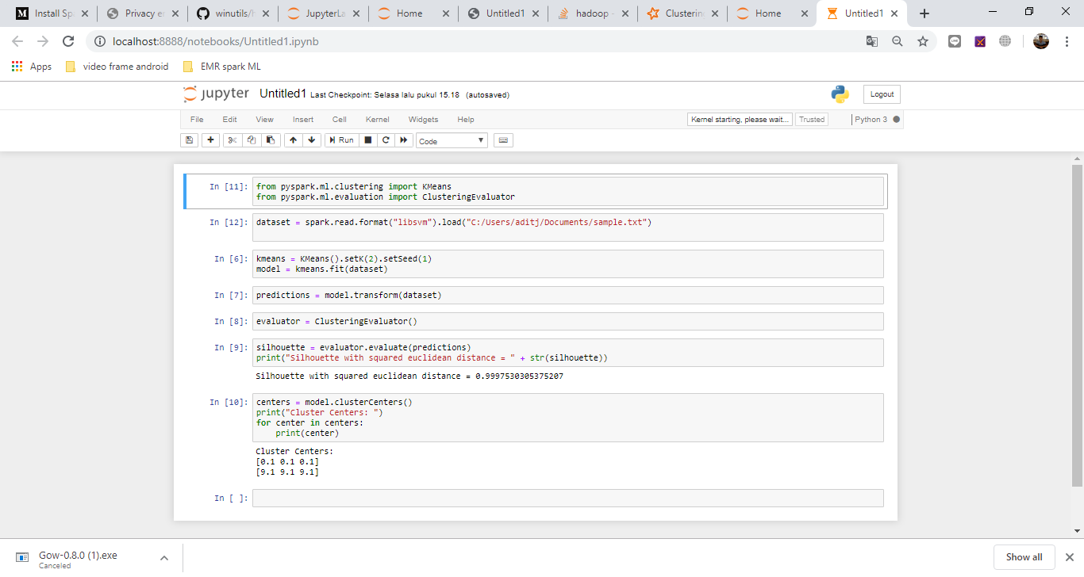
Move code to jupyter and change data directory

Slide 36
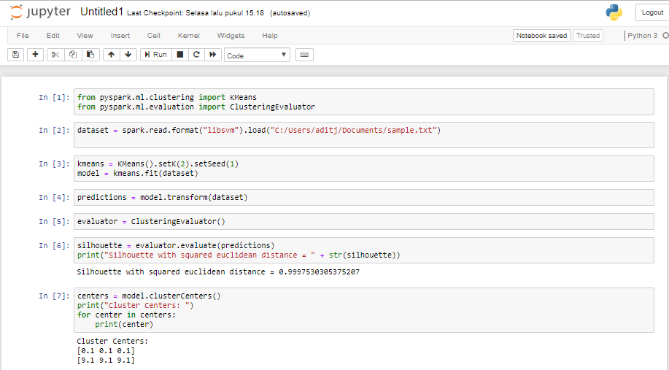
Run all cell code on jupyter
If there no error, ML is succesfully running

Slide 37
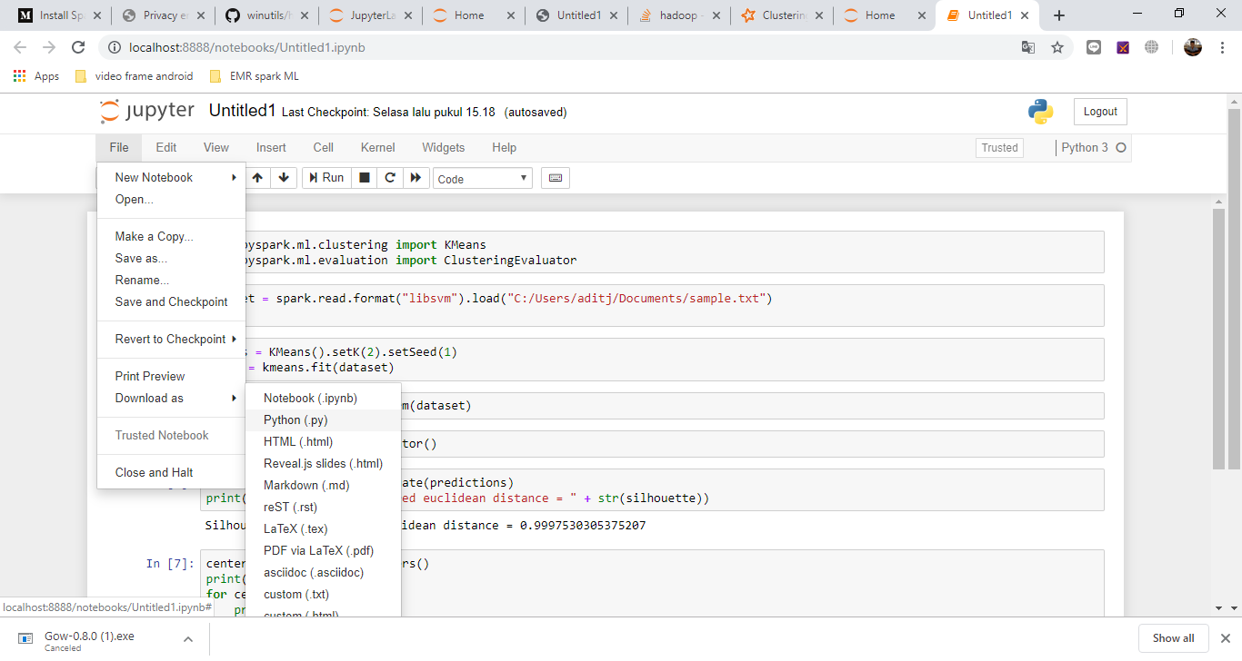
Download code to .py

Slide 38
Create Bucket on S3

Slide 39
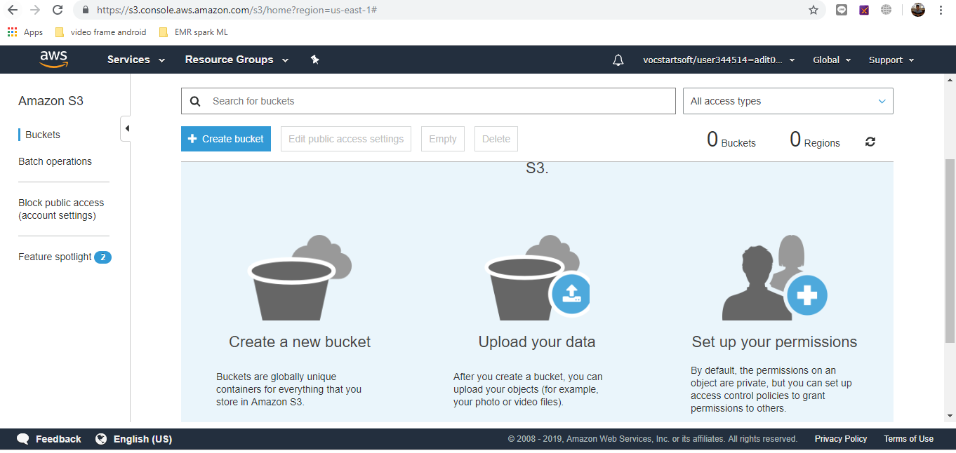
Open S3 Service on AWS Educate

Slide 40
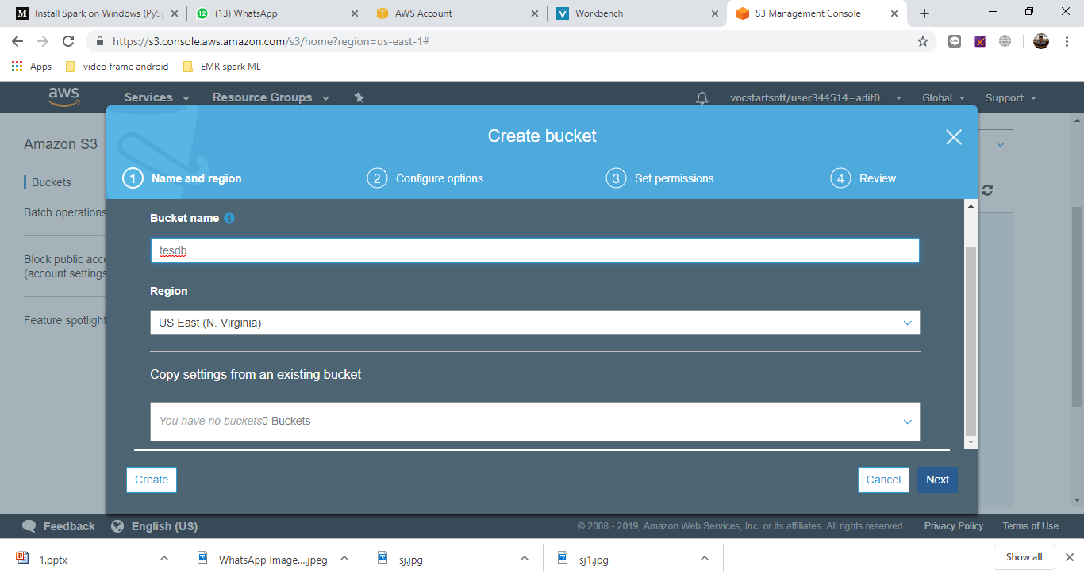
Create Bucket

Slide 41
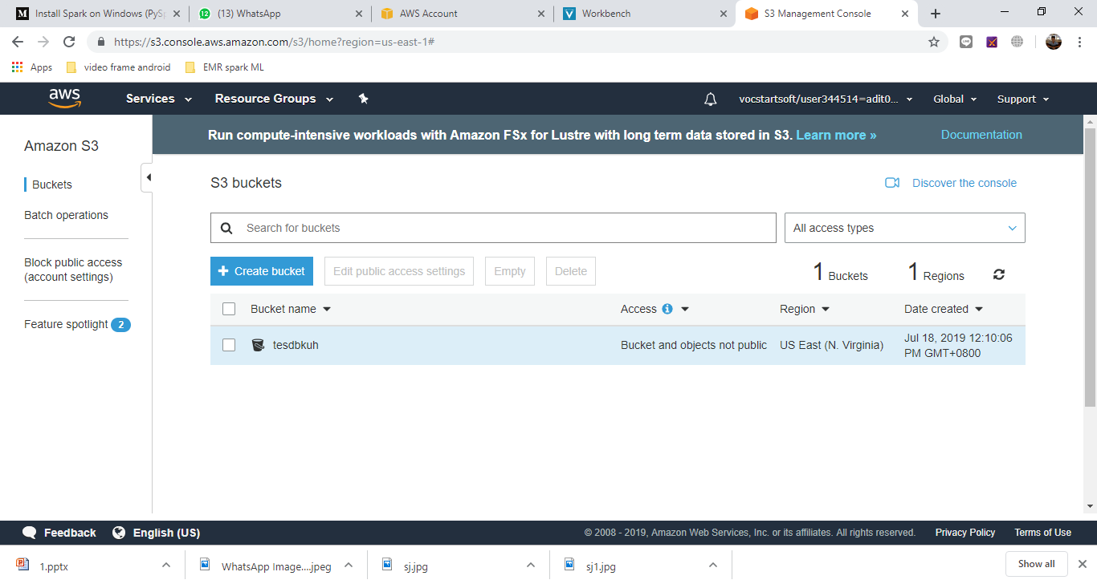
Open Bucket

Slide 42
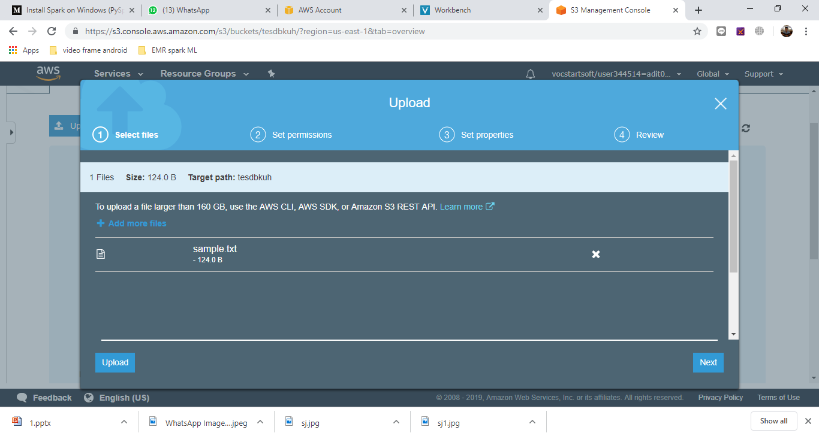
Upload sample data txt that was created before

Slide 43
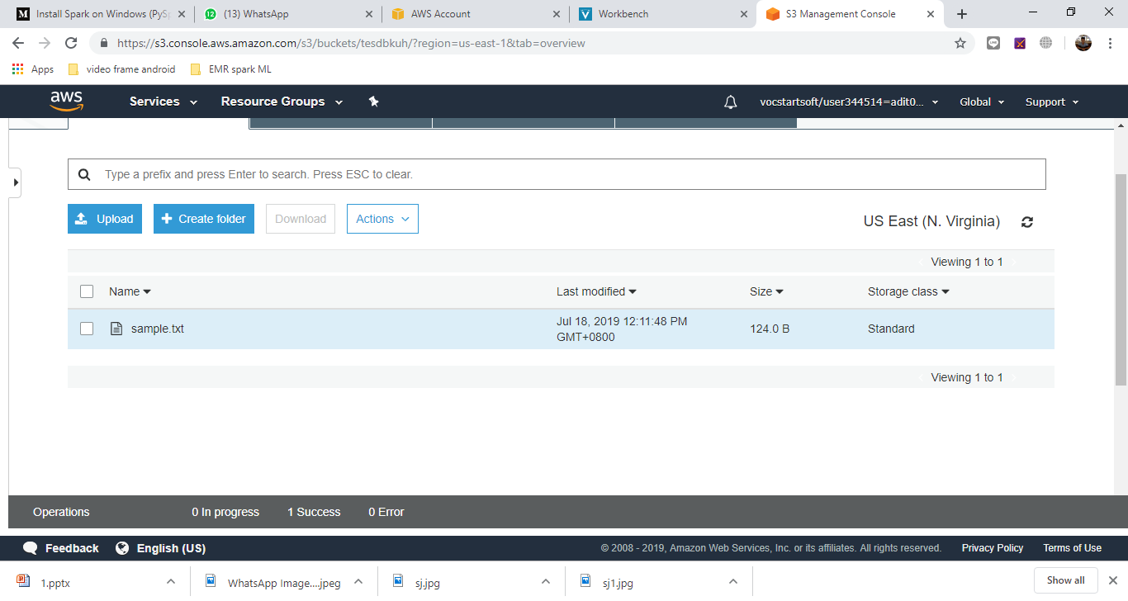
File succesfully upload

Slide 44
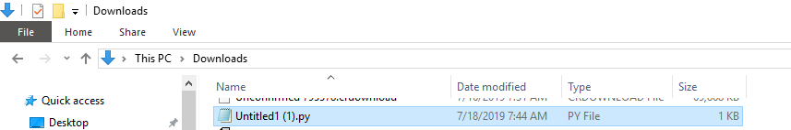
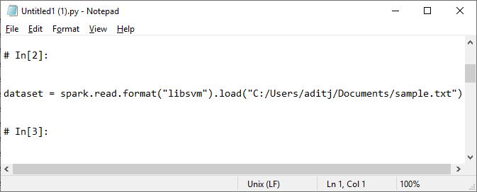
Edit directory file on python code
S3://tesdbkuh/sample.txt

Slide 45
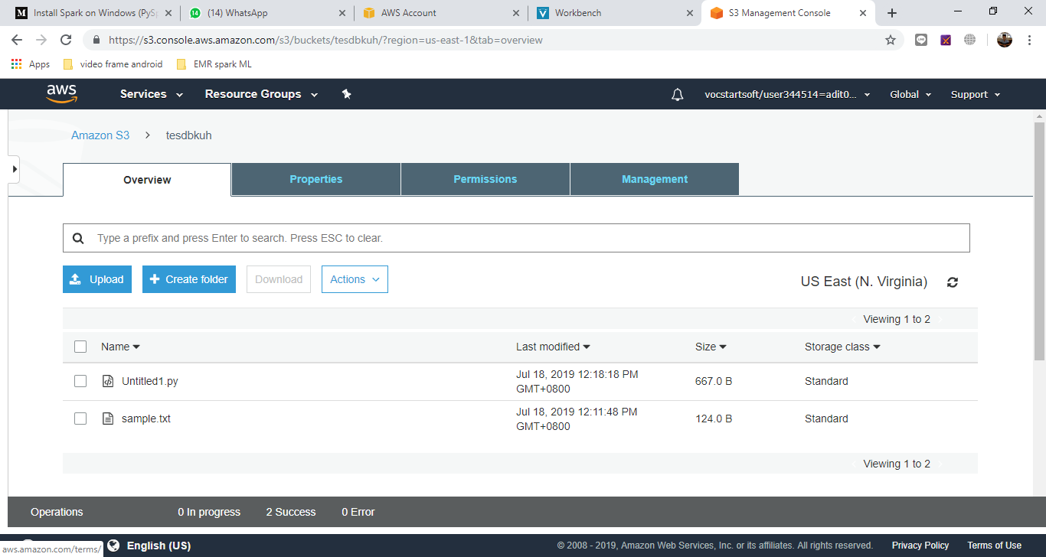
Upload file .py to s3

Slide 46
Create EMR Cluster

Slide 47
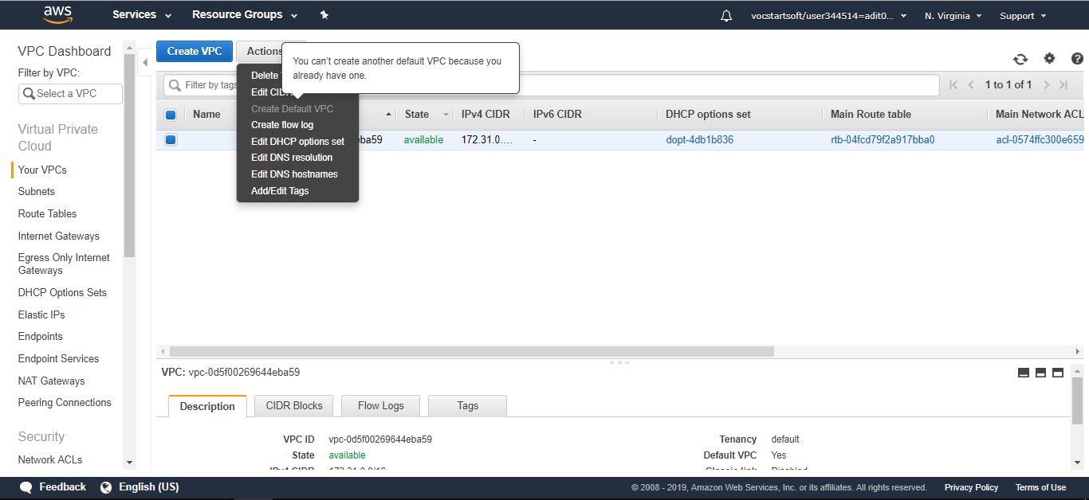
Cek default VPC
If default VPC is not available, create default vpc

Slide 48
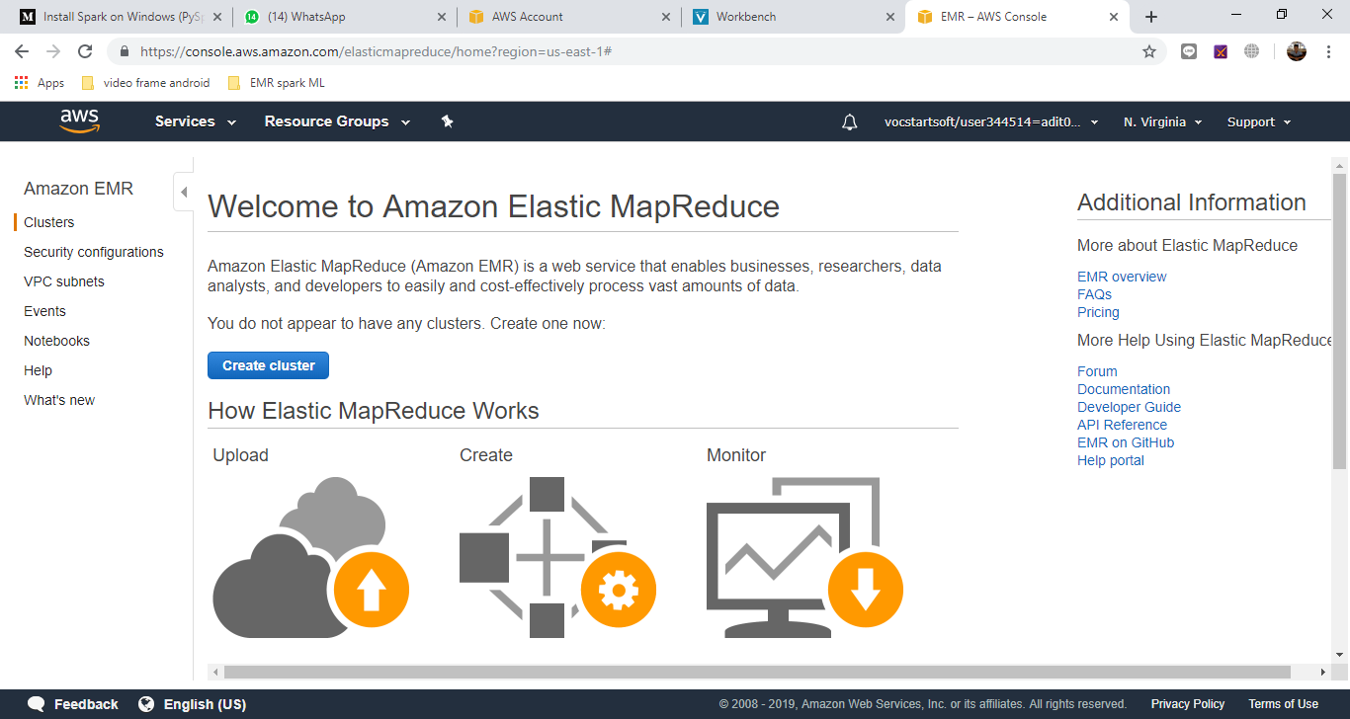
Open Service EMR AWS and create cluster

Slide 49
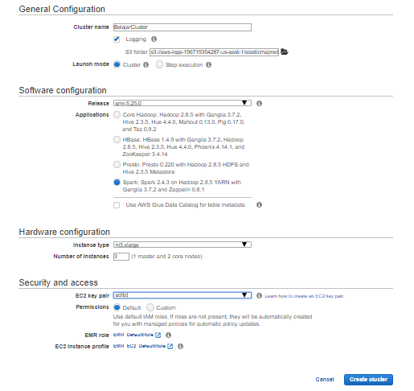
Fill configuration

Slide 50
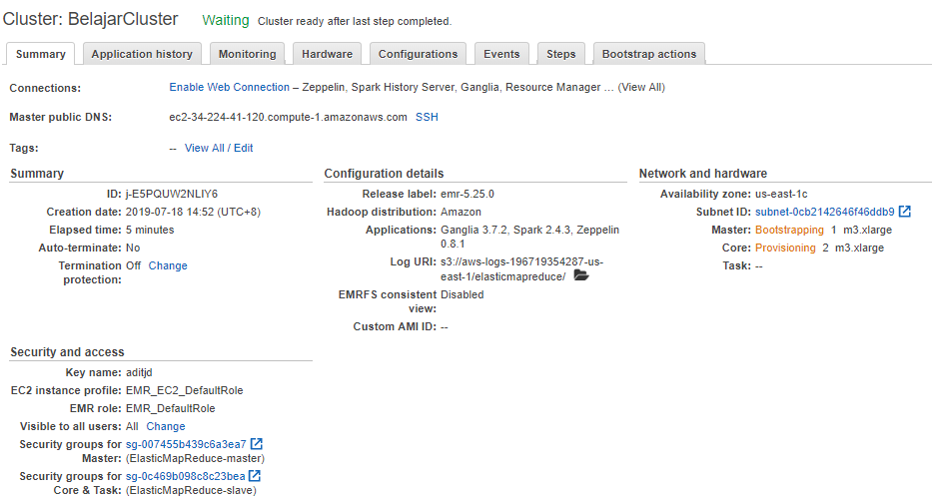
Choose security group for master

Slide 51
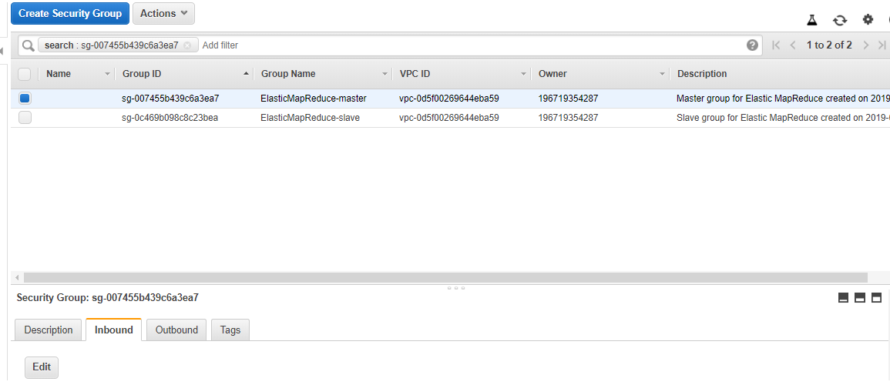
Edit inbound master group

Slide 52
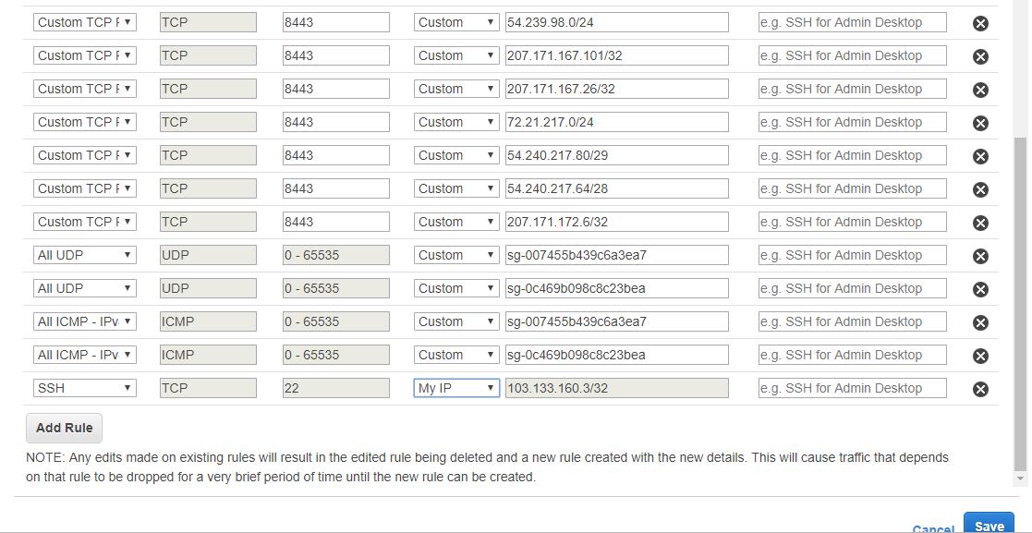
Add inbound rule and save

Slide 53
Connect to EMR with SSH

Slide 54
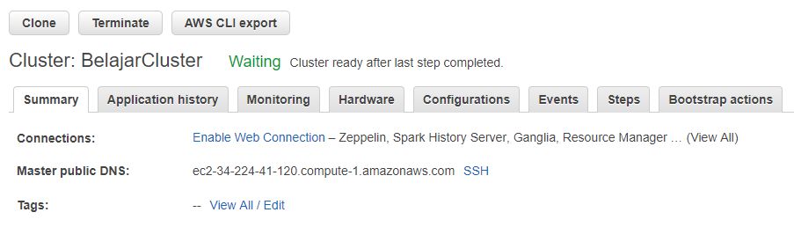
Display rule with clicking SSH to connect in cluster page

Slide 55
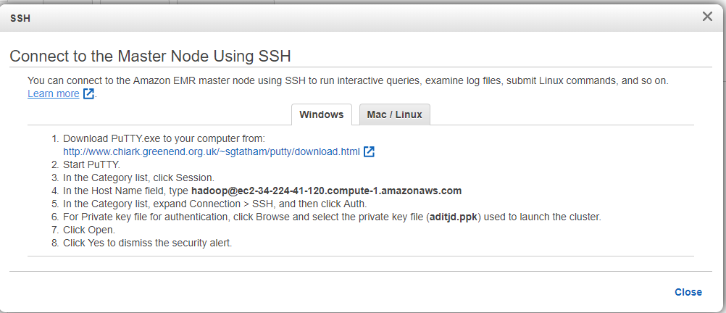
Follow the rule

Slide 56

Download Putty if no ready on device
Choose MSI 64 bit if your device is develop in 64 bit
Choose MSI 32 bit if your device is develop in 32 bit

Slide 57

Start Putty, if putty not ready please install first
Copy hadoop adrees to host name putty
Change hadoop with ec2-user

Slide 58


In the Category list, expand Connection > SSH, and then click Auth.

Slide 59

Directly click yes on putty alert

Slide 60

Yes, EMR successfully connect

Slide 61


Copy script python to local and run it on EMR
Aws s3 cp s3://tesdbkuh/Untitlled.py ./
Spark-submit –master yarn Untitlled.py

Slide 62

If there are an error like the picture, edit script and to add SparkContext and SparkSession

Slide 63

Edit file .py

Slide 64

Try to run the script again and succesfully running

